Slide 1
RAJALAKSHMI ENGINEERING COLLEGE
RIBE 2023
International Conference on Research and Innovation in Biomedical Engineering
Advancing Liver Tumor Segmentation: Integrating U-Net Architecture and Computed Tomography for Improved Diagnosis
Presented by:
Harish Nandhan S
Harshini J
Remoon Zean J
Mahi A R
Gopinath K
Department of Artificial Intelligence and Machine Learning

Slide 2
OUTLINE
Abstract
Introduction to Problem Domain
Existing system
Limitation of the Existing System
Proposed System
Architectural design of the Proposed System
Algorithm Used
Output
Results and Discussions
Future Enhancement
Conclusion
References

Slide 3
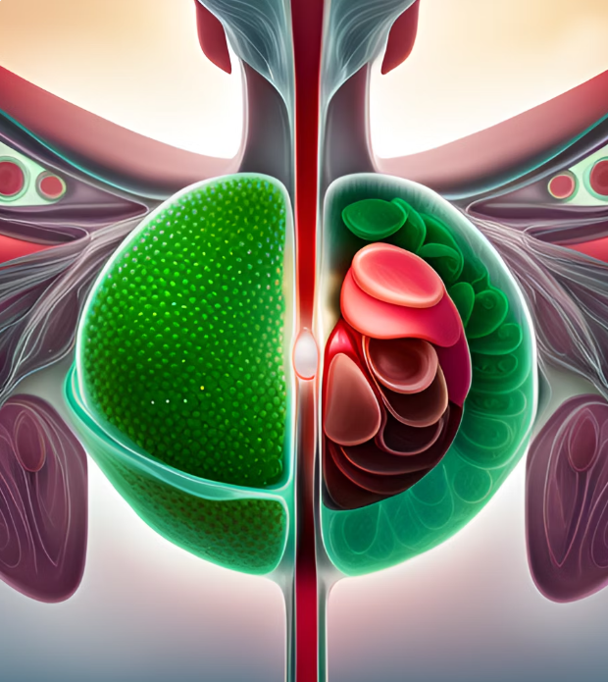
ABSTRACT
The liver facilitates in keeping healthy blood sugar levels, eliminating toxins from blood supply to the body, as well as regulating blood coagulation. Additionally, it will regulate the blood's chemical composition and release bile. Since the liver contains a variety of cell types, a variety of distinct tumor types can grow there. These aberrant growths may develop into malignant (cancerous) or benign (non-cancerous) cancers. The three most common malignant liver tumors are hepatocellular carcinoma, sarcoma, and hepatoblastoma. These illnesses cause weight loss, abdominal swelling, nauseousness, and vomiting. The final stage may also result in death. To eliminate and treat liver tumors as quickly as possible, earlier detection is required. The liver tumor is found using a medical imaging technique called Computed Tomography (CT), which is then sent to a convolution neural network architecture for biological image segmentation (UNET) that will precisely segment the liver's malignant cancer cells. In addition to the standard approach, a dropout regularization has been employed here to lessen the number of filters and prevent model bias. The dataset used to train the model was taken from the LiTS - Liver Tumor Segmentation Challenge (LiTS17) dataset, which contains roughly 130 CT scans for segmenting the liver and tumor lesions. The output will have a portion of the image that has been highlighted to show the presence of cancer cells, and the suggested methodology aids in the quick retrieval of tumor identification.

Slide 4
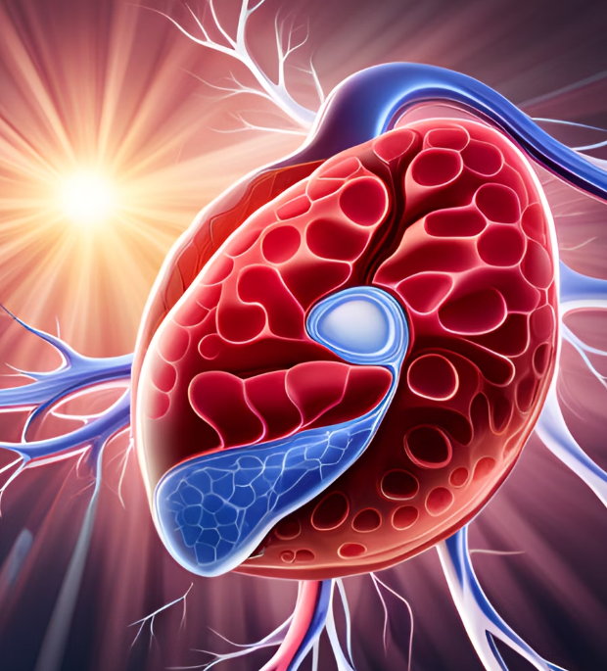
INTRODUCTION TO PROBLEM DOMAIN
Liver cancer is a leading cause of cancer-related deaths, necessitating early and accurate diagnosis. Computed Tomography (CT) aids in liver tumor detection, but manual segmentation is time-consuming and subjective. Deep learning, especially UNET, offers promising solutions, but challenges persist in accurately segmenting irregular tumor shapes and adjacent tissues. Integrating UNET with CT scans presents a viable approach to improve segmentation accuracy and sensitivity. This project aims to optimize UNET for liver tumor segmentation using a diverse CT dataset. By enhancing diagnostic precision, this research can revolutionize liver cancer care, enabling timely interventions and personalized treatment planning for better patient outcomes.

Slide 5
EXISTING SYSTEM
Sr. No | Author(s) | Year | Technique | Description | Outcome
1. | T. Rajalakshmi, U. Snekhalatha, and Jisha Baby | 2019 | Fast Greedy Snake Algorithm | The paper presents a liver tumor segmentation technique using the Fast Greedy Snake Algorithm in CT images, achieving accurate boundary delineation with a novel approach. | Enhanced liver tumor segmentation accuracy with the unique Fast Greedy Snake Algorithm, enabling precise boundary detection for medical applications.
2. | M. Sharma and R. Parveen | 2021 | K- Means clustering | The paper explores the application of image processing techniques for liver cancer detection, utilizing advanced computer science methods to enhance accuracy and efficiency in diagnosis. | Unique approach leveraging image processing algorithms, leading to improved liver cancer detection capabilities, potentially aiding in early diagnosis and treatment planning.
3. | N. Nasiri, M. H. Foruzan, and Y.-W. Chen | 2020 | Integration of a knowledge-based constraint into generative models | The paper introduces a novel method that combines generative models with a knowledge-based constraint for semi-automatic segmentation of liver tumors, aiming to enhance segmentation accuracy and efficiency. | Enhanced liver tumor segmentation with knowledge-based generative models.
4. | S. Sabut, A. Das, S.S. Panda, and P. Das | 2019 | Modified fuzzy clustering and decision tree classifier | The paper presents a liver cancer detection method utilizing modified fuzzy clustering to segment CT images, followed by a decision tree classifier for accurate classification, aiming to improve early diagnosis of liver cancer. | Enhanced liver cancer detection using modified fuzzy clustering and decision tree classifier in CT images.
5. | Dr. S. Vijayarani, Mr. S. Dhayanand | 2020 | Support Vector Machine (SVM) and Naïve Bayes Algorithms | The paper presents a liver disease prediction method using SVM and Naïve Bayes algorithms, aiming to accurately classify patients into disease and non-disease categories based on relevant features extracted from medical data. | High accuracy by merging SVM and Naïve Bayes.
Date Slide Number

Slide 6
LIMITATIONS OF EXISTING SYSTEM
Sr. No | Limitation
1. | The fast greedy snake algorithm may struggle to accurately segment liver tumors with irregular or complex shapes, leading to potential inaccuracies in tumor boundaries.
2. | The performance of the modified fuzzy clustering method could be sensitive to the choice of parameters, and finding the optimal parameters may be challenging.
3. | The knowledge-based constraint may heavily rely on the accuracy of the prior knowledge, which could introduce biases and limitations to the segmentation results.
4. | The semi-automatic level set segmentation approach may require significant manual intervention, which can be time-consuming and labor-intensive.
5. | The cascaded deep residual networks approach may demand a large amount of computational resources and time for training due to the complexity of the deep learning models.

Slide 7
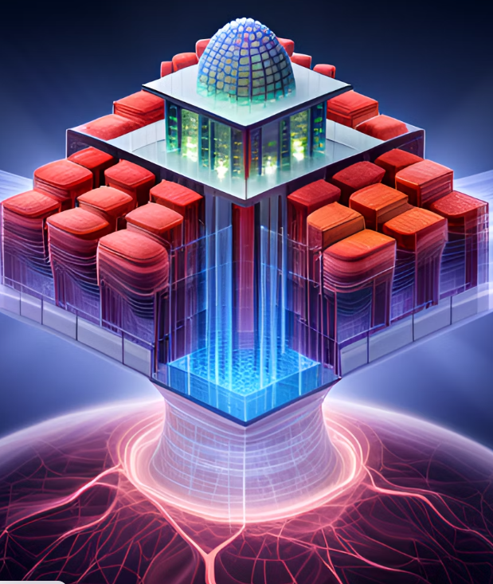
PROPOSED SYSTEM
The proposed system will build upon an existing deep learning-based approach for computing BMI from facial images.
The system will involve data preprocessing, face detection and alignment, feature extraction using a Multi-Task Cascaded Convolutional Neural Networks (MTCNN) model, and BMI prediction through training and fine-tuning a deep learning model using a large image dataset.
The effectiveness of the proposed system will be evaluated using a dataset of facial images and corresponding BMI measurements as a .csv file.
Standard performance metrics such as mean absolute error and mean squared error will be used to train and evaluate the model.
Potential applications of this approach in healthcare and wellness monitoring will be explored, including the development of a mobile application or website for real-time BMI calculation.
The implementation of the proposed system aims to contribute to the development of more accurate, efficient, and non-invasive methods for calculating BMI with the potential to improve patient outcomes and support public health initiatives.

Slide 8
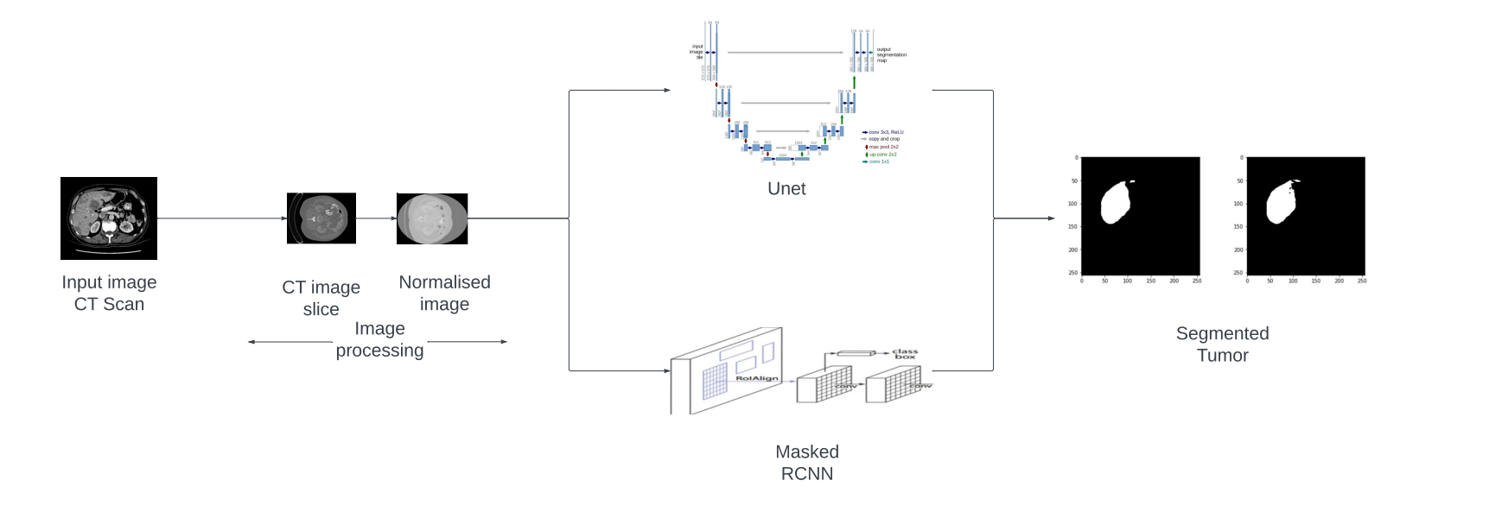
ARCHITECTURAL DESIGN OF THE PROPOSED SYSTEM

Slide 9
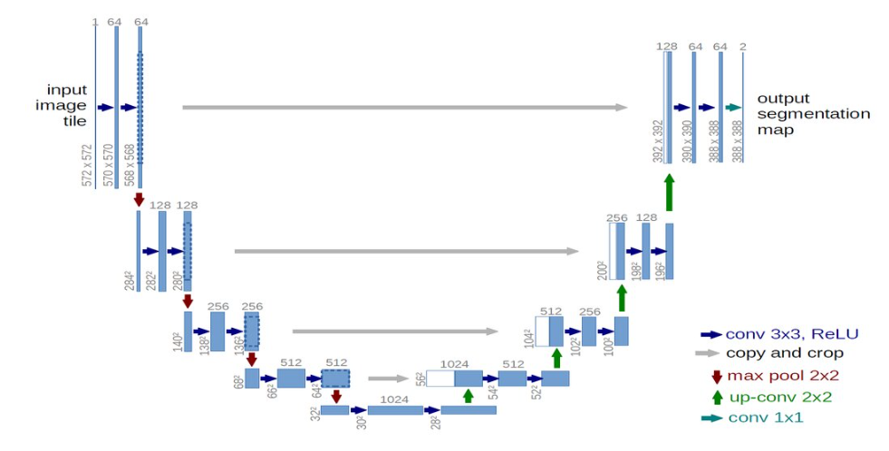
ALGORITHM USED
U-Net
U-Net is a widely used deep learning architecture for semantic segmentation tasks, especially in medical image analysis. Introduced in 2015, it was designed primarily for biomedical image segmentation.
Key components of U-Net:
1. Encoder: Captures relevant contextual information and extracts high-level features using convolutional layers with ReLU activation and max pooling.
2. Bridge: A bottleneck layer that retains high-level features learned by the encoder and maintains spatial information.
3. Decoder: Upsamples encoded features using transposed convolutions and utilizes skip connections to access both high-level and low-level features from the encoder.
4. Output: Employs a 1x1 convolutional layer with a sigmoid activation function to generate a binary mask representing pixel-wise probabilities of the target class.
U-Net's effectiveness lies in its ability to handle small training datasets, making it popular in biomedical image segmentation tasks like CT scans and MRI. The use of skip connections mitigates the vanishing gradient problem, enabling the model to learn from both local and global information and produce accurate segmentation results.

Slide 10
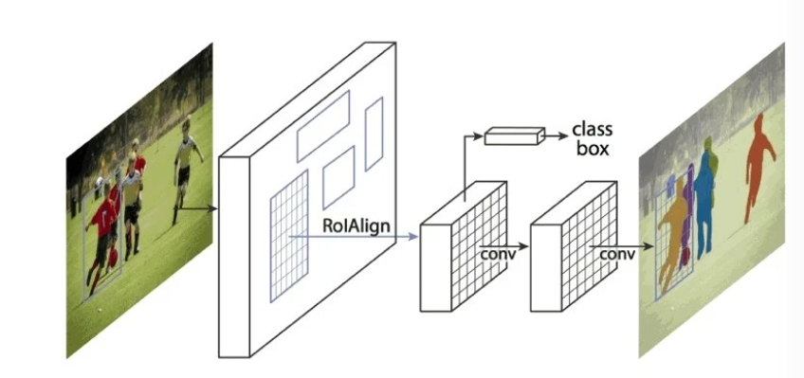
Masked R-CNN
ALGORITHM USED
Mask R-CNN is an extension of Faster R-CNN, a popular object detection model, designed for instance segmentation. It includes pixel-level segmentation masks along with bounding box predictions.
Key components of Mask R-CNN:
1. Region Proposal Network (RPN): Generates candidate bounding boxes (ROIs) in an image.
2. Feature Extraction: Uses a shared CNN backbone (e.g., ResNet, VGG16) to extract feature maps for each ROI.
3. ROI Pooling: Converts ROIs into fixed-size feature maps for handling ROIs of varying sizes.
4. Classifier and Bounding Box Regression: Predicts the object class and bounding box coordinates for each ROI.
5. Mask Prediction: Adds a branch for predicting pixel-wise segmentation masks for each ROI.
6. Output: Provides bounding box predictions, class predictions, and segmentation masks for detected object instances.
Mask R-CNN is widely used in instance segmentation tasks where the goal is to segment each object instance in an image with high accuracy and detail. Its ability to provide both bounding boxes and pixel-level segmentation masks makes it a powerful tool in computer vision applications.

Slide 11
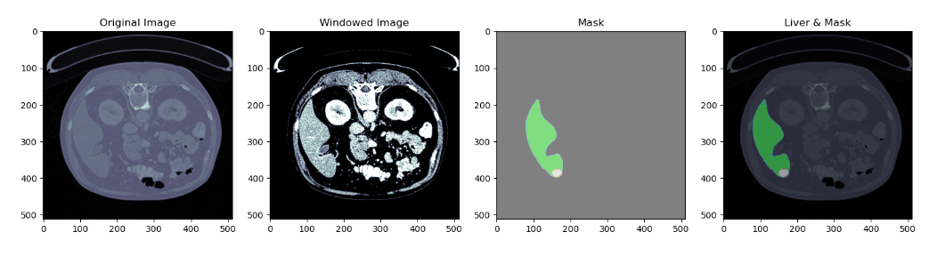
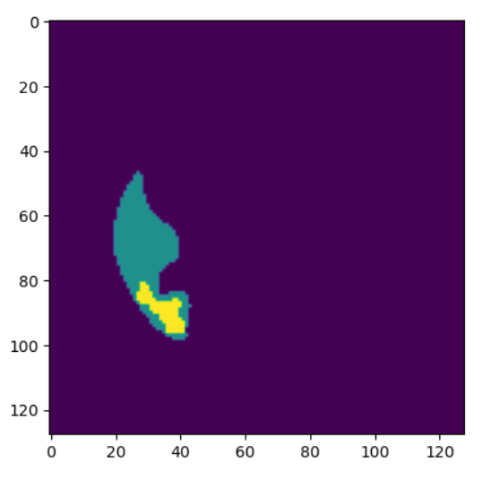
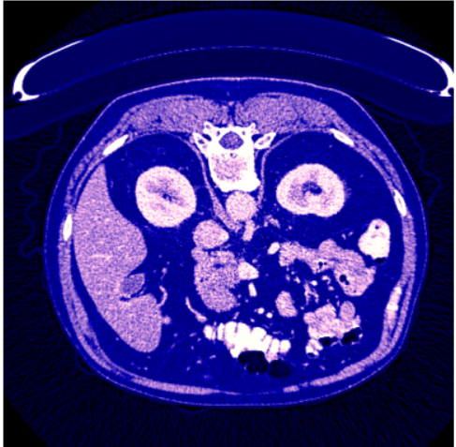
OUTPUT
INPUT IMAGE
INPUT IMAGE ( TEST FILE )
OUTPUT IMAGE (AFTER VISUALIZATION)

Slide 12
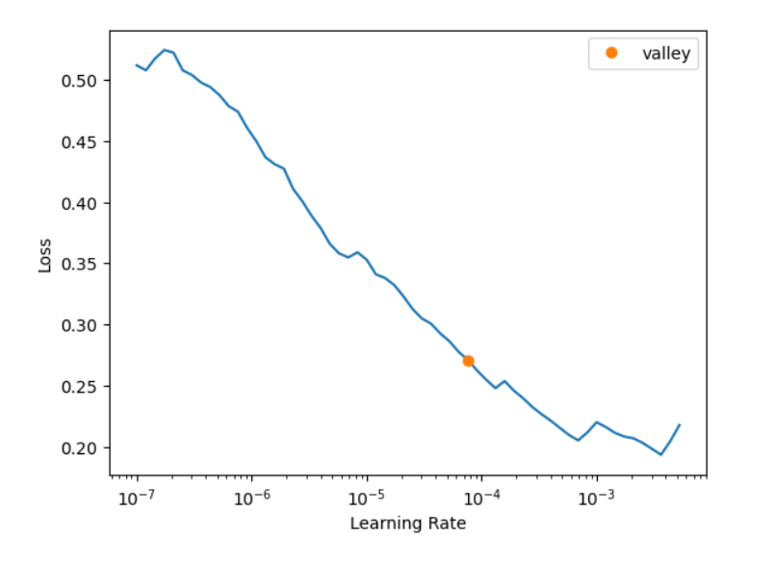
RESULTS AND DISCUSSIONS
The proposed method combining UNet and ResNet backbone Mask R-CNN for liver tumor segmentation has shown impressive results in accurately detecting cancer cells early on. By maintaining the current kernel and filters without increasing the number of filters, we achieved early tumor detection with high accuracy.
We preprocessed all CT scans by normalizing them before training the model. The iterative training process with modified learning rates reduced errors and improved model performance.
The combination of U-Net and ResNet backbone Mask R-CNN enhanced instance segmentation by accessing both high-level and low-level features. This improved segmentation precision compared to earlier models.
The approach achieved better accuracy with less computational expense, making it suitable for deployment on various cloud platforms. It has great potential in multispecialty hospitals for early liver tumor detection, allowing prompt treatment initiation.
Moreover, its implementation in CT scan centers enables patients to determine liver tumor presence at an early stage, improving patient outcomes and treatment planning.
The combined approach of U-Net and ResNet backbone Mask R-CNN offers a practical and effective solution for liver tumor segmentation in medical image analysis. Its accuracy, efficiency, and applicability in clinical settings make it a valuable tool in advancing liver tumor diagnosis and patient care.

Slide 13

FUTURE ENHANCEMENT
Real-Time Segmentation: Optimize the model architecture and implementation for real-time inference on standard clinical workstations, allowing for immediate access to tumor segmentation during routine clinical assessments.
3D Segmentation: Adapt the UNET architecture to handle 3D CT scans, allowing volumetric segmentation of liver tumors, which can provide a more detailed and holistic view of tumor characteristics and growth patterns.
Online Learning: Develop a system that can continuously update the model with new data to adapt to evolving tumor characteristics and improve its performance over time.
Web-Based Interface: Develop a user-friendly web-based interface for liver tumor segmentation, allowing radiologists and oncologists to access the model remotely from any device with an internet connection.
Collaborative Platform: Enable collaborative features in the web application, allowing multiple healthcare professionals to work together on tumor segmentation and treatment planning
Feedback Mechanism: Integrate a feedback mechanism in the web application to gather user feedback and improve the segmentation model over time based on real-world usage

Slide 14

CONCLUSION
In conclusion, the integration of the UNET architecture with computed tomography has demonstrated promising results in advancing liver tumor segmentation. By fine-tuning the UNET model on a diverse dataset of CT scans, we have achieved improved accuracy and sensitivity in identifying liver tumors. The computer-aided segmentation approach holds great potential in enhancing early detection and precise delineation of tumor boundaries, thereby facilitating timely interventions and personalized treatment strategies for liver cancer patients. Moreover, this research bridges the gap between cutting-edge deep learning techniques and real-world clinical applications, paving the way for future advancements in medical image analysis and improving overall patient care. As liver cancer remains a significant global health challenge, the success of this project holds promising implications for better outcomes and improved prognosis for affected individuals.

Slide 15
REFERENCES
1. T. Rajalakshmi, U. Snekhalatha, and Jisha Baby, "Segmentation of liver tumor using fast greedy snake algorithm," Biomedical Engineering: Applications, Basis and Communications, vol. 31, no. 02, pp. 1950013, 2019.doi: 10.4015/S1016237219500133
2. S. Sabut, A. Das, S.S. Panda, and P. Das, "Detection of liver cancer using modified fuzzy clustering and decision tree classifier in CT images," Pattern Recognition and Image Analysis, vol. 29, no. 2, pp. 201-211, June 2019.doi: 10.1134/S1054661819020056.
3. J Muthuswamy, "Extraction and Classification of Liver Abnormality Based on Neutrosophic and SVM Classifier," Advances in Intelligent Systems and Computing, vol. 713, pp. 287-296, 2019, Springer, Singapore.doi: 10.1007/978-981-13-1708-8_25.
4. H. Jiang, T. Shi, Z. Bai, and L. Huang, "AHCNet: An Application of Attention Mechanism and Hybrid Connection for Liver Tumor Segmentation in CT Volumes," IEEE Access, Special Section on Deep Learning for Computer-Aided Medical Diagnosis, vol. 7, pp. 74310-74320, 2019. doi: 10.1109/ACCESS.2019.2899608.
5. M. Sharma and R. Parveen, "The Application of Image Processing in Liver Cancer Detection," International Journal of Advanced Computer Science and Applications, vol. 12, no. 10, 2021. doi: 10.14569/IJACSA.2021.0121050.
6. Z. Bai, H. Jiang, and Y.-D. Yao, "Liver Tumor Segmentation Based on Multi-Scale Candidate Generation and Fractal Residual Network," IEEE Access, vol. 7, pp. 84046-84055, 2019. doi: 10.1109/ACCESS.2019.2923218.
7. D. Smeets, D. Loeckx, B. Stijnen, B. De Dobbelaer, D. Vandermeulen, and P. Suetens, "Semi-automatic level set segmentation of liver tumors combining a spiral-scanning technique with supervised fuzzy pixel classification," Med Image Anal, vol. 14, no. 1, pp. 13-20, Feb. 2010. doi: 10.1016/j.media.2009.09.002. PMID: 19828356.
8. N. Nasiri, M. H. Foruzan, and Y.-W. Chen, "Integration of a knowledge-based constraint into generative models with applications in semi-automatic segmentation of liver tumors," Biomed. Signal Process. Control, vol. 57, pp. 101746, Mar. 2020.

Slide 16
THANK YOU

